Slide 1
Project 2: Water Electric Heater

Slide 2
CONTENTS
01
02
03
Introduction
Hardware
Software

Slide 3
Introduction
01

Slide 4
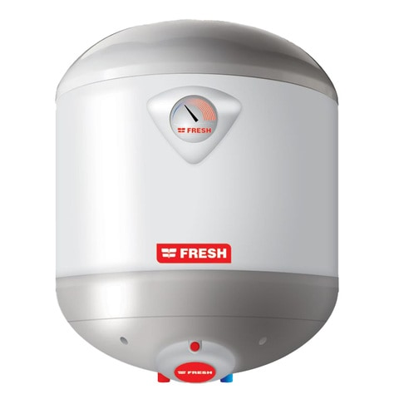
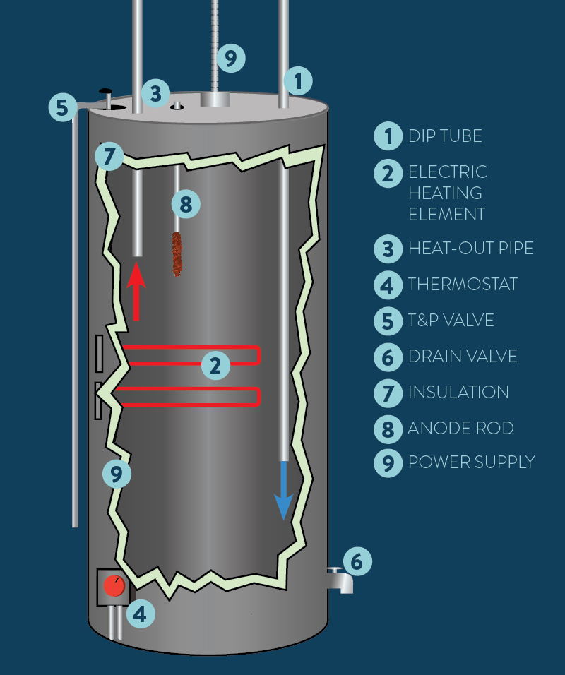
Introduction

Slide 5
Introduction
System Requirements
1
Temperature Setting
2
Temperature Sensing
Temperature range (35 to 75 ℃)
Set Temperature using up and down buttons
Store tempratures in memory
Sense tempratue of the container
Get average value of every 10 readings
control heater and cooler using set temprature
℃
3
ON/OFF Behavior
4
Heating/Cooling Elements
Power is connected system is off by default
System switches between two states when on /off button is pressed
Heater is ON and Cooler is OFF if readings is less than the set temperature by 5℃
Cooler is ON and Heater is OFF if readings is more than the set temperature by 5℃

Slide 6
Hardware
02

Slide 7
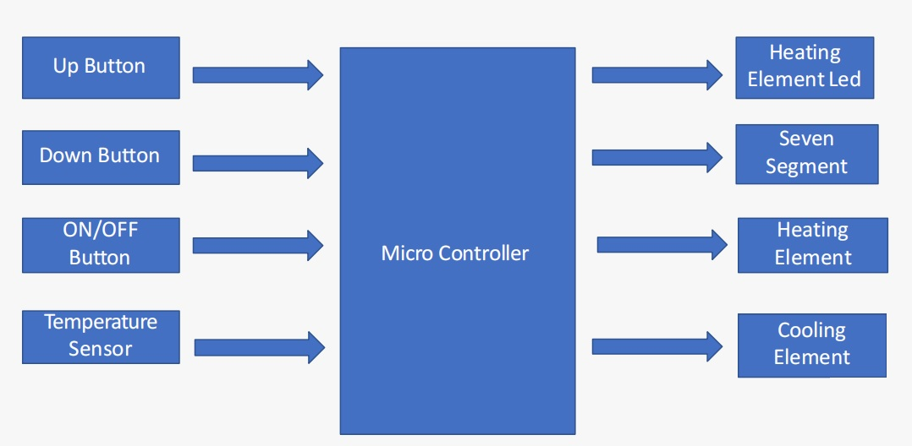
Hardware
System components Diagram

Slide 8

Hardware
Sensor
Cooler
Heater
ON/OFF
Inside The Heater
Outside the Heater

Slide 9
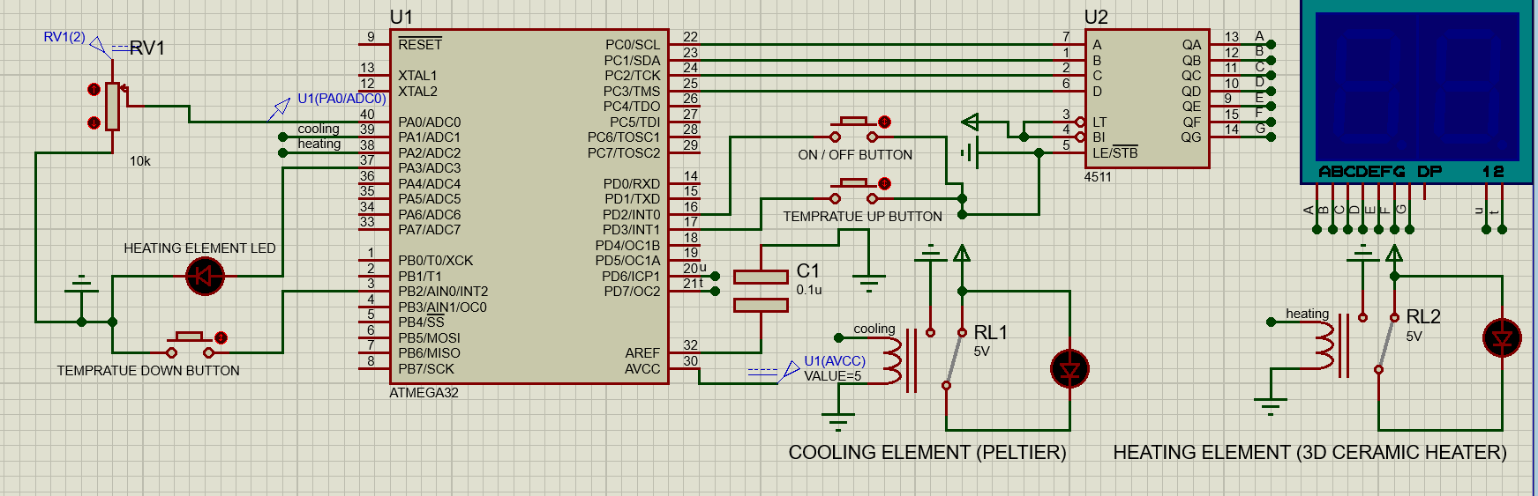
Hardware
System Circuit on Proteus

Slide 10
Software
03

Slide 11
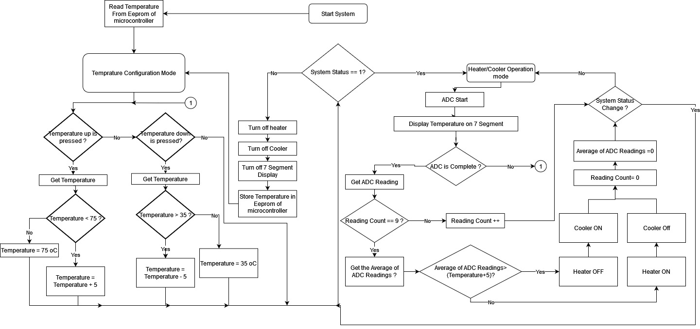
Software
System Flowchart/state machine

Slide 12
Software
Temprature Configuration mode
System Status Interrupt
State = 0
State = 1
Heater/Cooler Operation mode
System state machine

Slide 13
THANK YOU！

